Slide 1

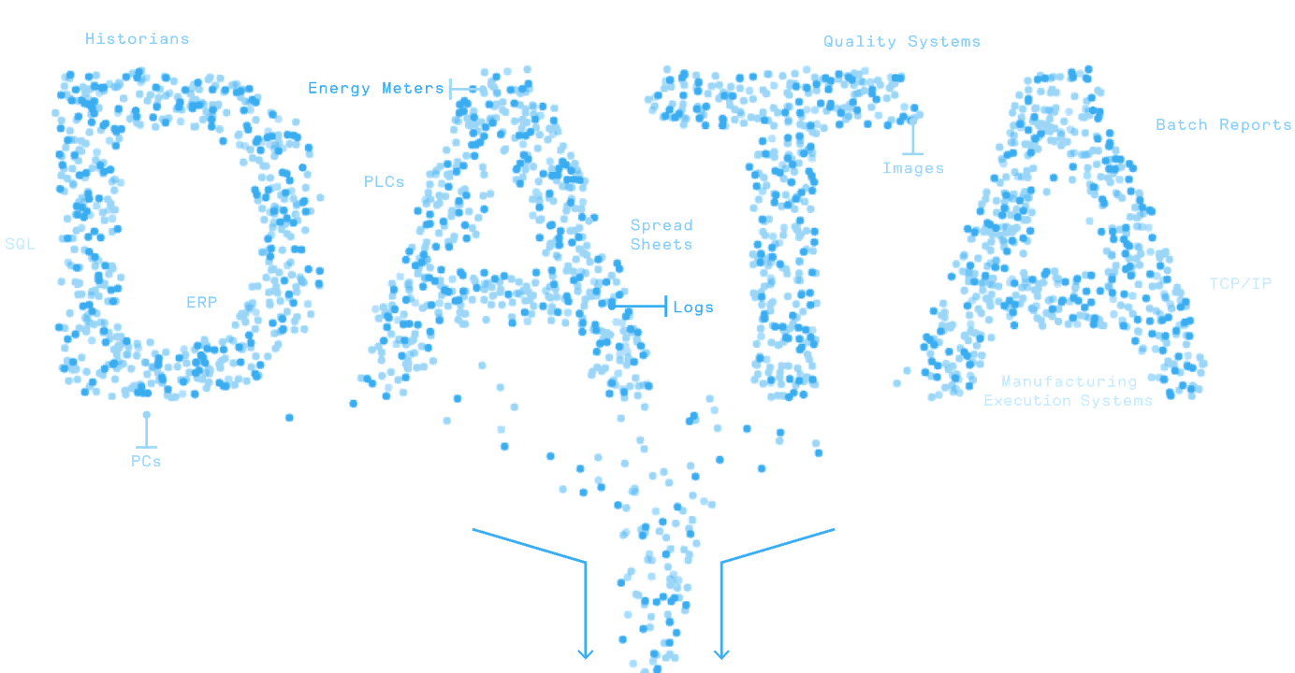


MATLAB Fundamental Laboratory Handbook (MATLAB)
Chapter 6 Scripts and Functions
Dr Leo Chen
leo.chen@ieee.org
1

Slide 2
Why need function
Increase reusability (a function can be called more than once).
Increase readability (functions can be placed independently of the main program).
Simplified program Structure and management of a complexity project.
Script 1
Script 2
Function
Notes:
As the complexity of your scripts increases, you will most likely find that certain pieces of code are repeated in several different places. In this case, it makes sense to package this segment of code as a separate code that you can call with a single command. In this way you reduce maintenance effort: if you change this block of code, you now need change it in one place only. This separate code that you can call with a single command is Function.

Slide 3
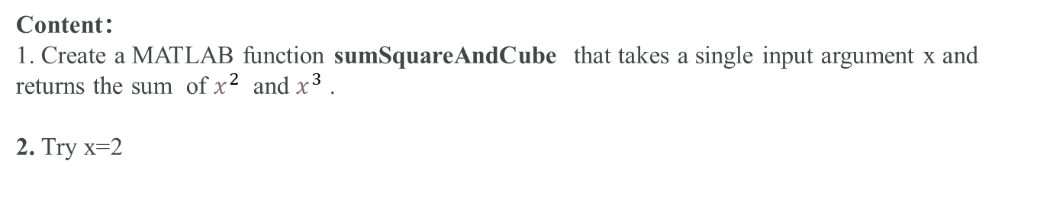
6. 1 Lab
Objective: Practice user-defined Function
Content：
1. Create a MATLAB function sumSquareAndCube that takes a single input argument x and returns the sum of $x^{2}$ and $x^{3}$ .
2. Try x=2
edit sumSquareAndCube.m
F1 = sumSquareAndCube(2)

Slide 4
6. 2 Lab
Objective: Practice user-defined Function
Content：
Create a MATLAB function file that takes a single input argument n and returns a vector of the first n pyramid numbers. The n pyramid number, P(n) represents the number of blocks in a pyramid made from an n-by-n square of blocks at the base, an (n-1)-by-(n-1) square on top of that, and so on. It can therefore be calculated as
2. Add statements to check that n is a positive integer before performing the calculations.
3. Try :
p = imhotep2(7) p = imhotep2(7.3) p = imhotep2(-7)
$$P\left(n\right)=1^{2}+2^{2}+⋯+n^{2}$$
Edit imhotep2.mlx

Slide 5
6. 3 Lab
Objective: Practice Variable Numbers of Arguments Function
Content：
1. Create a MATLAB function who_is_bigger with two input arguments a and b and return the bigger one.
2. Try who_is_bigger(2, 3)
edit who_is_bigger.m
who_is_bigger (2, 3)

Slide 6
6. 4 Lab
Objective: Practice Anonymous Functions and Function Handles
Content：
Use an anonymous function to compute the integral of $x^{2}$ from 0 to 1
q = integral(@(x) x.^2,0,1);
https://ww2.mathworks.cn/help/matlab/ref/function_handle.html

